Slide 1


AI-Driven Skin Cancer Detection:
A Comprehensive Review of Deep Learning Techniques for Early Intervention
Name: Abhishek S. Waghchaure
Affiliation: Dr. Vishwanath Karad MIT World Peace University, Pune, India
Notes:
1

Slide 2

Contents
Introduction
Background of the Paper
Methodology of Review
Existing Techniques
Comparative Analysis
Key Findings
Challenges and Limitations
Future Directions
Conclusion
References
Conference Acronym
Notes:
2

Slide 3
Introduction
Skin cancer is among the most common cancers worldwide, with increasing incidence rates.
Early detection significantly improves treatment outcomes and survival rates.
Traditional diagnostic methods rely on visual inspection and biopsies, which are time-consuming and prone to human error.
Recent advances in Artificial Intelligence (AI) and Deep Learning (DL) offer promising alternatives for enhancing diagnostic accuracy and efficiency.
This review explores the current state of AI-driven approaches for skin cancer detection, focusing on deep learning techniques.
Conference Acronym

Slide 4
Background of the
Paper
Definition and Types of Skin Cancer: Skin cancer is characterized by the uncontrolled growth of abnormal skin cells. Types include basal cell carcinoma, squamous cell carcinoma, and melanoma.
The Role of AI and Deep Learning in Medical Diagnostics: AI and deep learning, particularly CNNs, enhance diagnostic accuracy and efficiency in medical imaging and pathology.
High Mortality and Recurrence Rates of Skin Cancer: Despite advancements, skin cancer remains a significant health challenge due to high mortality and recurrence rates.
Conference Acronym

Slide 5
Methodology Of Review
Comprehensive Literature Survey of Existing Techniques: The review includes a broad survey of literature, focusing on the application of AI in skin cancer detection.
Analysis of Various Deep Learning Approaches: The paper analyzes different CNN architectures and their effectiveness in detecting and classifying skin cancer.
Evaluation Criteria and Metrics Used in the Review: Metrics such as accuracy, sensitivity, and specificity are used to evaluate the performance of various techniques.
Conference Acronym

Slide 6
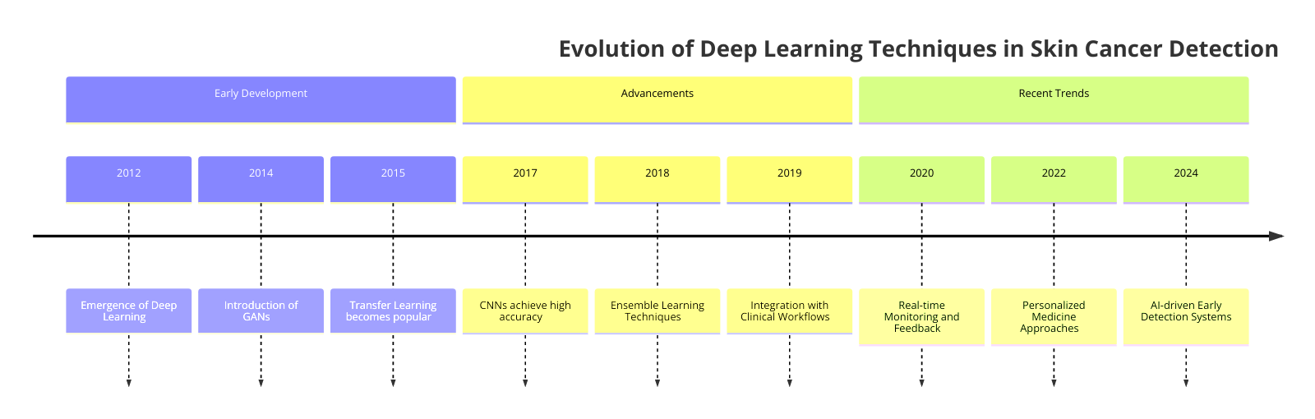
Existing Techniques
Overview of CNNs Used in Skin Cancer Detection: CNNs are a type of deep learning model particularly effective in image recognition and classification tasks.
Conference Acronym

Slide 7
Existing Techniques
Different Datasets Used in the Reviewed Papers
Ham1000: Includes 3 class classification.
ISIC 2019 Dataset: Majorly used for segmentation models like Seg-Net.
Various Datasets: Include nine types of skin cancers such as melanoma, basal cell carcinoma, and squamous cell carcinoma.
Caucasian race and xanthous-race datasets : Data set having dark skin tone having cancer.
Conference Acronym

Slide 8
Comparative Analysis
VGG16 | U-Net
16 layers with 13 convolutional layers, 5 pooling layers, and dense layers. Input size: 224x224 RGB images. Hyper-parameters: 3x3 filters, stride 1, same padding; 2x2 maxpool layers with stride 2. Filter sizes: Conv-1 (64), Conv-2 (128), Conv-3 (256), Conv-4 & 5 (512). | Contracting path (encoder) captures contextual information and reduces input resolution. Expansion path (decoder) generates segmentation maps. Includes convolutional and max pooling layers.
Data Augmentation: Techniques like rotation, flipping, resizing, and additional transformations improve data quality. | Dataset Enhancement: Incorporates central point ground truth (CGPT) for better training.
Precision, Sensitivity, Specificity, Accuracy, and Youden Index evaluated on dataset.Accuracy in most papers was 81.24%. | Performance Evaluation: IoU (Intersection over Union) used to assess segmentation accuracy (37.2% IoU).
Object detection and classification, known for transfer learning. | Semantic segmentation in medical imaging.
Conference Acronym

Slide 9
Comparative Analysis
Comparison of Techniques:
Automated methods like Mobile-Net, Res-Net, Alex-Net, VGG16, and VGG19 were compared for their performance on skin cancer datasets .
MobileNet outperformed others with an accuracy of 81.24%, highlighting its potential for clinical application .
Other models like ResNet and VGG16 also showed high performance but with variations depending on the dataset and specific implementation details.
Conference Acronym

Slide 10
Key Findings
Effective Identification and Classification:
Deep learning approaches can accurately differentiate between malignant and benign lesions, aiding in early detection and treatment.
Insights from the Literature Survey:
The survey indicates a need for more diverse datasets to improve model robustness across different skin types and demographics.
Explainable AI (XAI) models have been suggested to enhance the trustworthiness and transparency of AI diagnostics, achieving F1 scores of up to 94.55% on the ISIC dataset .
Advanced AI Techniques and Their Potential:
Techniques like data augmentation, generative adversarial networks (GANs), and the use of explainable AI (XAI) frameworks like LIME have been proposed to further enhance model performance and interpretability.
Conference Acronym

Slide 11
Challenges and
Limitations
Data Scarcity and Bias:
Insufficient large-scale, diverse skin lesion datasets.
Most datasets predominantly feature images of white skin, leading to color bias.
Accuracy drops when testing on diverse skin types.
Model Interpretability:
Deep learning models, particularly CNNs, are often seen as "black boxes."
Lack of transparency and interpretability in AI decisions reduces trust among dermatologists.
Overfitting Issues:
CNN models show susceptibility to overfitting, especially with limited data.
Overfitting hampers the generalization capability of models across new, unseen data.
Conference Acronym

Slide 12
Future Directions
Enhancing data diversity through advanced data augmentation techniques and new dataset collection.
Developing explainable AI models to improve interpretability and trust.
Focusing on real-world validation and optimizing model performance for diverse populations.
Addressing healthcare disparities by tailoring AI algorithms for community-based settings.
Development of user-friendly interfaces for broader adoption by both clinicians and patients.
Conference Acronym

Slide 13
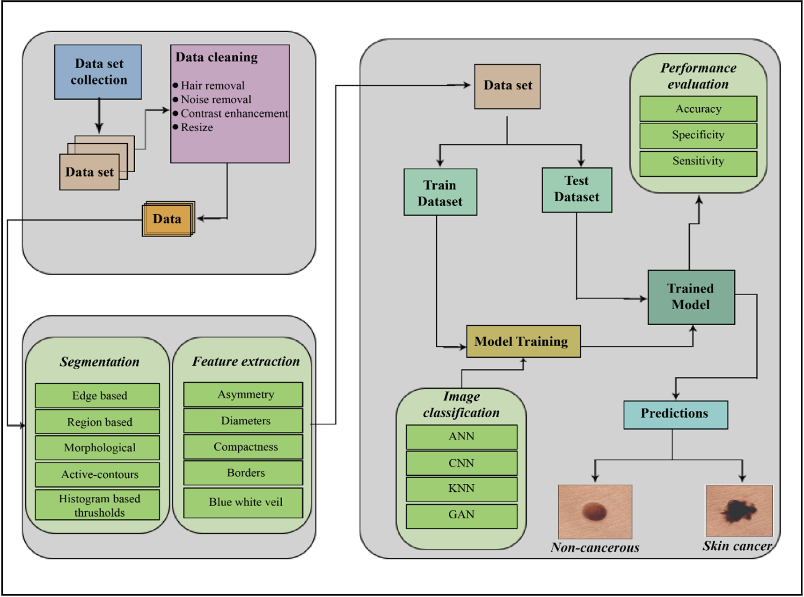
Future Directions
Conference Acronym

Slide 14
Conclusions
The comprehensive literature review underscores the advancements and effectiveness of AI in dermatological research.
Identified both strengths and areas needing further research in AI applications for skin cancer detection.
Studies showed VGG16's effectiveness in classifying skin cancer, achieving up to 81.24% accuracy.
U-Net performed well in skin cancer segmentation, achieving 37.2% Intersection over Union (IoU) using central point ground truth.
It supports healthcare providers by reducing manual diagnostic workloads, allowing focus on more complex patient cases.
The integration of AI in skin cancer detection can transform dermatology by providing quick, accurate, and consistent diagnoses.
Conference Acronym

Slide 15
References
Ni, Weiguo.Implementation of a Convolutional Neural Network (CNN)-based Object Detection Approach for Smart Surveillance Applications. International Journal of Advanced Computer Science and Applications, 2023.
Chaoyi Zhang, Jin Xu, Rong Tang, Jianhui Yang, Wei Wang, Xianjun Yu, and Si Shi, "Novel Research and Future Prospects of Artificial Intelligence in Cancer Diagnosis and Treatment," Journal of Hematology & Oncology, 2023
Yogesh Kumar, Surbhi Gupta, Ruchi Singla, Yu‑Chen Hu, "A Systematic Review of Artificial Intelligence Techniques in Cancer Prediction and Diagnosis," Archives of Computational Methods in Engineering, 2022.
M. Jędryka, "Translational molecular research has established a novel clinical approach in endometrial cancer patients," Advances in Clinical and Experimental Medicine, vol. 32, no. 2, pp. 141-145, Jan 13, 2023.
Conference Acronym

Slide 16
Thank You
Conference Acronym

